Slide 1
Workshop on Asphaltene Properties and Processing
Trouble Connecting?
Call in (audio only)
+1 647-749-1699,,107292817# Canada, Toronto
(844) 615-8188,,107292817# Canada (Toll-free)
Phone Conference ID: 107 292 817#
Assistance: linda.russell@albertainnovates.ca

Slide 2
Workshop on Asphaltene Properties and Processing
Murray Gray, Senior Technical Advisor
Advanced Hydrocarbons, Clean Resources
National Partial Upgrading Committee
February 2021

Slide 3
National Partial Upgrading Committee
Collaborative group focused on promoting and de-risking technologies for bitumen partial upgrading
Active since circa 2010
Oilsands operators
  CNOOC
  Cenovus
  CNRL
  Imperial Oil
  Suncor
Government research and policy
  Alberta Energy
  Alberta Innovates
  Natural Resources Canada – CANMET Energy and CANMET Materials

Slide 4
Asphaltenes in Bitumen
Defined as fraction soluble in toluene, insoluble in n-pentane (C₅-asphaltenes) or n-heptane (C₇-asphaltenes)
Non-distillable under vacuum, so form part of the vacuum residue fraction
Value of crude oil depends multiple properties, including:
  content of vacuum residue
  sulfur content
  Tendency to form coke during thermal cracking

Slide 5

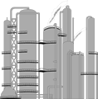

Current Fate of Asphaltenes in Bitumen – Mining with Coking-Upgraders
Mining
Extraction
Upgrader
Pipeline
Synthetic Crude Oil
(SCO)
No asphaltene
All asphaltene converted to coke, gas, or liquid product
Tailings
Coke to Mine
CNRL Horizon, Suncor Base Plant, Syncrude

Slide 6
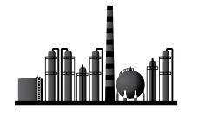
Current Fate of Asphaltenes in Bitumen – Mining with Paraffinic Froth Treatment
Mining
Extraction
Add Diluent
for Pipeline
Upgrader
Pipeline
CNRL Albion
Deep Conversion Refinery
Part of
Asphaltenes
With fines
Kearl Fort Hills
Coke to fuel

Slide 7

Current Oilsands Operations – In Situ
Diluted Bitumen Shipment to Refineries
Production
Pipeline
Deep Conversion Refinery
Dilbit
Diluent to reduce viscosity
(Significant volume recyled via pipeline and reused)
Coke to fuel

Slide 8
Paradigms for Asphaltene Processing
20th century
  Coker-based upgraders enable transport of mined bitumen
  Coke is a potential energy resource
  Dilbit transport from In Situ production
2000-2020
  Partial removal of asphaltenes to transport mined bitumen
  Asphaltenes are a potential resource
Future
  Optimal use of oilsands infrastructure
  International drive for net-zero GHG emissions by 2050

Slide 9
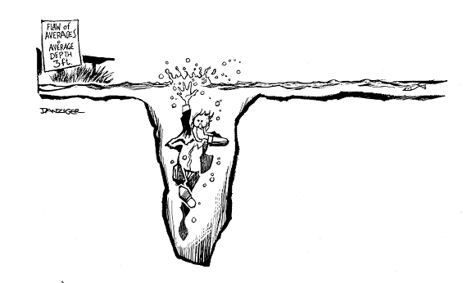
Challenge 1: Asphaltenes are an extraordinarily complex mixture of diverse molecules
The Flaw of Averages
Average Depth = 1 m

Slide 10
Amount of Asphaltene Precipitation Can Be Tuned
Athabasca bitumen, 40:1 solvent; Mitchell and Speight, 1973

Slide 11
Challenge 2: Solvent precipitation is not chemically selective
Fractionation of asphaltenes from different crudes using solubility

Slide 12
Challenge 3: Chemical analysis is difficult because:
Asphaltene molecules stick together to form very stable nanoaggregates, from dimers up to perhaps 50 molecules
  Solutions are not individual molecules in solvent/crude oil
  Persist at very hig dilution, high temperature, in strong solvents
Todays presentations will show you how nanoaggregation and complexity of the mixture can be overcome but
Much of the published literature on asphaltene chemistry features overinterpretation of biased data!

Slide 13
Challenge 4: New ideas for asphaltenes
New insights into asphaltene behavior
New ways of manipulating behavior, composition, and products
Current process options too limiting for future fuels/materials
  Solvent deasphalting
  Thermal cracking and coking
  Conversion with catalyst and hydrogen
  Yields and performance boundaries for these approaches are well understood

Slide 14
Workshop Hypothesis
“The asphaltene fraction contains building blocks of material that are valuable for production of fuels, and material that is potentially valuable for carbon products.”

Slide 15
Workshop Objectives
Inform oilsands industry researchers on the current science of asphaltene molecular composition and behavior.
Prompt the development of research projects on novel approaches to defining asphaltene behavior and enhancing utilization of this material by separations and or reactions.

Slide 16
Agenda
Start | End | Agenda Item
09:00 | 09:20 | Workshop Opening – Murray Gray, Alberta Innovates
09:20 | 09:50 | Industry Panel – Challenges and Opportunities in Dealing with Asphaltenes Moderator: Jinwen Chen (CANMET) Participants: Brad Komishke (Teck), Todd Pugsley (Suncor), Scott Smith (Cenovus)
09:50 | 11:50 | Research Presentations Session Chair: Mrudula Paranjape, CNRL
12:00 | 13:00 | Lunch
13:00 | 14:30 | Poster Sessions
14:30 | 15:00 | Round Table on Potential Research and Path Forward for Projects Moderator: Shunlan Liu, Alberta Innovates

Slide 17
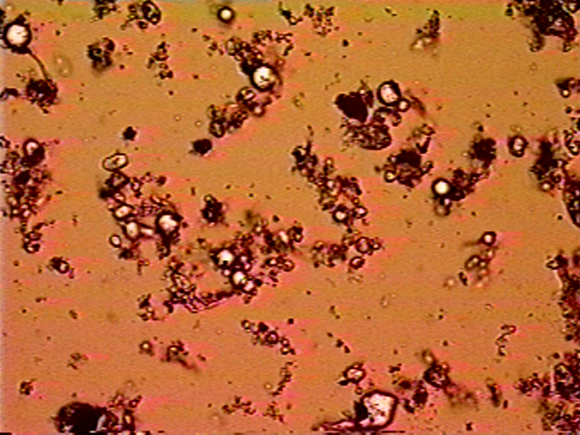
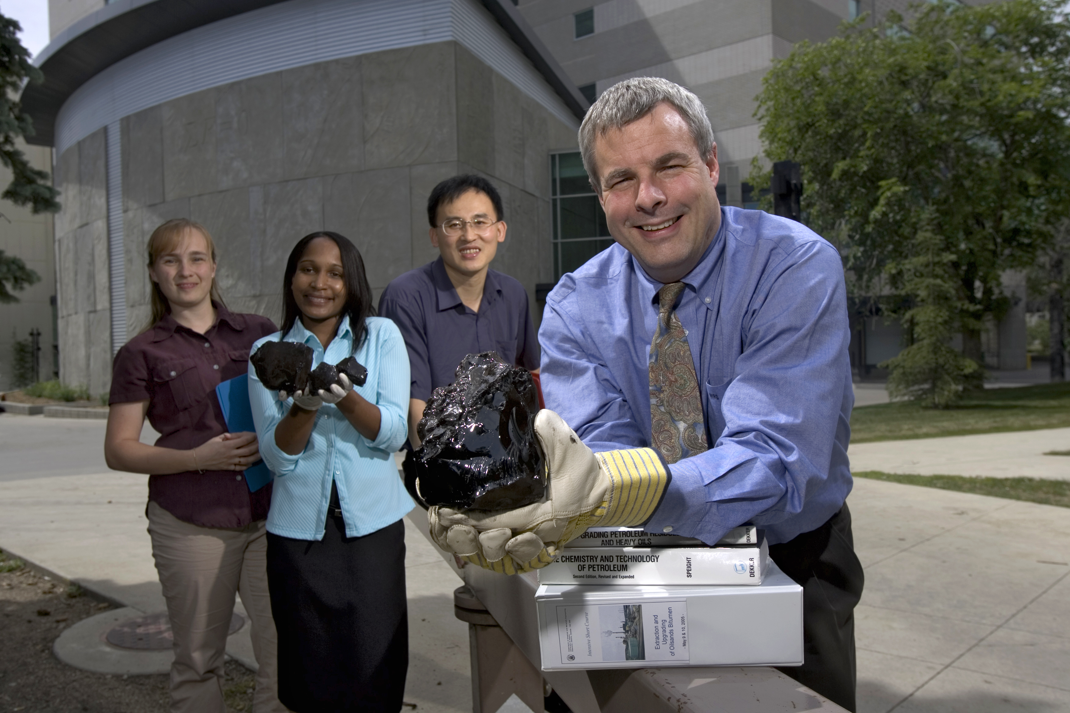
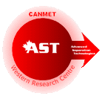
Let’s talk asphaltenes!
CANMET WESTERN RESEARCH CENTRE
ADVANCED SEPARATION TECHNOLOGIES

Slide 18
Trouble Connecting?
Call in (audio only)
+1 647-749-1699,,107292817# Canada, Toronto
(844) 615-8188,,107292817# Canada (Toll-free)
Phone Conference ID: 107 292 817#
Assistance: linda.russell@albertainnovates.ca

