Slide 1
Secondary Use Data Project - Plans and Progress Tim Murphy Research Data Management Week May 6, 2016

Slide 2
What are we trying to achieve?

Slide 3
Primary & Secondary Data Defined
Secondary Use Data– using a patient’s information for any purpose not directly related to the care of an individual.
Secondary Use Data
Primary Use Data
Secondary Use Data
Primary Use Data
Primary Use Data – Patient health information used to provide health services to a patient
Source: College of Physicians and Surgeons of Alberta

Slide 4
Personalized, Precision Medicine
Your Life
50%
Your Healthcare
25%
Your Biology
15%
10%
Your Environment

Slide 5
The Ecosystem of Human Health Data
Outcomes Data
Environmental Data
7x24 Biometric Monitoring Data
Genomic & Familial Data
Healthcare Encounter Data
Social Data

Slide 6
Context
Alberta’s Population
Integrated Health System
Health Partners
Some of the Best Secondary Use Data in the World

Slide 7
Secondary Use Data Project
What is it? A reminder of our charter…
“Health and health related clinical, socio-economic, multi-jurisdictional government, administrative and self-reported data that has been aggregated, analyzed, privacy-protected and made accessible to inform decision-making in support of strategy, planning, policy-making, service delivery, care, research and commercial efforts to benefit Alberta and Albertans.”

Slide 8
What are we trying to achieve?
Integrate disparate data to:
1
Improve the quality of care provided to every patient, on a personal level
2
Reduce the cost of delivering high quality care
3
Improve the overall health of the community while reducing the overall economic drain of poor health on the community
4
Accelerate the pace of clinical research

Slide 9
Custodians / data holders
All Albertans
Data Users
Individual Albertans interacting with health and other systems
Value

Slide 10
July 2015 report to Government of Canada Health Minister
Chapter 7 - Channeling the Data Deluge, Mapping the Knowledge Frontier
“Precision medicine is an approach to medicine in which diagnostic, treatment, and prevention strategies are tailored to subpopulations of patients or even personalized at the individual level.”
“We urgently need a strategy for moving precision medicine to the clinical front-lines, and for turning the sophisticated data arising from such clinical encounters back into generalizable research findings.”
“Access to data and information among patients, providers, researchers, and policymakers is inconsistent. The Panel heard that data access is particularly difficult for clinicians and researchers in certain provinces who have no choice but to buy raw data or customized analyses from other jurisdictions.”

Slide 11
Who is involved?

Slide 12
Participants
Policy Makers
Quality
Improvement
Experts
Albertans
Researchers
Health Professionals
Committee on Academic Medicine

Slide 13
Phase 1 Working Group Focus and Chairs
Public Engagement
Co-chairs Sharon Nettleton and Deborah Prowse
Represent interests of Albertans regarding use of data
Determine strategy to receive ongoing feedback from Albertans
Privacy & Access
Co-chairs Mary Marshall and Lawrence Richer
Examine the balance between access to data & individual privacy
Minimize risks to privacy; maximize value of data through access
Data & Analytics
Co-chairs Kathryn Todd and Stafford Dean
Identify inclusive data asset inventory for secondary use
Determine the access and tools required for effective use of data
Infrastructure & Applications
Co-chairs Susan Anderson and Penny Rae
Determine infrastructure required to house, maintain, and share data
Support and automate features and functions required to use the data
Enabling Legislation
Chair Roger Palmer
Identify legislative opportunities and hurdles to the concept
Collaborate to draft regulations and amendments as appropriate
Governance & Structure
Chair Dale Sanders
Develop trusted governance that represent interests of all stakeholders
Determine legal structures required to create, govern, and operate HIR

Slide 14
How are we going to do this?

Slide 15
Progress to Date
Kick-off:
March 12, 2015
July 31, 2015
Fall, 2015
November 30, 2015
Six working groups formed
Over 70 people from 18 different public, government, and private company organizations
Final reports from working groups plus a summary report from the Steering Committee
About 160 pages in total
Findings and recommendations presented to key stakeholders
Endorsement of Phase 2 Demonstration Projects
Present Phase 1 high level requirements gathered
Kick off Phase 2 of project

Slide 16
General Strategy
Add data content that is not currently available to provincial stakeholders, to a solution that uses new and existing technological infrastructure
Step 1
Step 3
Integrate and link existing and substantial data currently available, working together to create a provincial vision for secondary use data
Consolidate existing stakeholder data content using big data technologies
Step 2
Policy for data integration
Engagement of public, industry, and stakeholders

Slide 17
Bringing People and Data Together
Secondary Use Data Project
Existing P-HAN Governance Structure
Existing Initiative-Specific Governance Structures
Existing Initiative-Specific Governance Structures
Some Existing Governance Structures
Developing Governance Structure
Currently No Governance Structure
AH + AHS Data
Other Government of Alberta Data
Community Data
Allied Health Professional Data
Physician Data
Other Data
(i.e. Provincial Health Analytics Network; P-HAN)
(e.g. Education, Human Services, Child Youth Data Laboratory)
(e.g. HQCA Data, Research Groups)
(e.g. Pharmacy, Physiotherapy, Dietitian, etc.)
(i.e. Physician Data Co-op)
(e.g. Public Data, Industry Data)
2015
2022

Slide 18
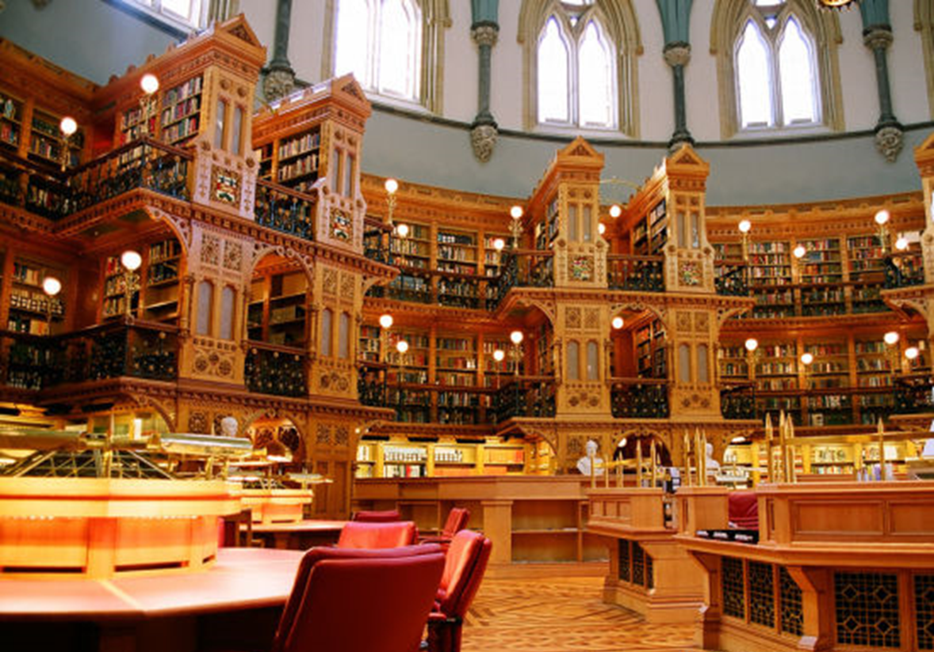
Building a Data Library
Notes:
Eventually have petabytes worth of data available with appropriate access, security, and privacy safeguards.
Image: Library of the Canadian Parliament

Slide 19
Developing a Curated Selection of Integrated Data Holdings
ETC
RESEARCH
Claims
JUSTICE
PHAN
ENVIRONMENT
NACRS
DIMR
DAD
EDUCATION
Notes:
Vision – expand the current limited bookshelf to include more and more volumes of health and health-related data sources.

Slide 20
Feedback from Lay Advisory Committee
It was assumed that data is centrally stored
There is surprise that data is not readily available (in a timely manner) for research and quality improvement.
Can you guarantee people's information is non-identifiable and secure?
Coordination with other jurisdictions
Balance between privacy and use of data
How co-ordinated are the electronic patient information systems?
Will secondary use data be available for commercial use? If so, who will get the money and how will it be used?
Notes:
From Institute of Health Economics Lay Advisory Committee October 23, 2015
It was assumed that data is centrally stored
There was concern about security when stored at several sites that are not standardized for protection and integration.
Provided the information is non-identifying, it seems to be a "no brainer" that it is not already available for research, improving the health care system
Are we coordinating with other jurisdictions working on these kinds of initiatives?
Does Alberta have too many privacy laws that complicate secondary use of patient data?
How co-ordinated are the electronic patient information systems?
Can you guarantee people's information is non-identifiable and secure?
Will it be available for commercial use? If so, who will get the money and how will it be used?

Slide 21
Phase 2 Timeline
Requirements & Business Case
Data
Asset Roadmap
Requirements Gathering
Demonstration Project Portfolio Coordination
Data Integration and Linkage Policy Development
Pre-Phase 2
Month 1
2
3
4
5
6
7
8
9
10
Phase 3
Demonstration Projects Privacy Impact Assessment(s)
Demonstration Projects
Release of Aggregate Data Assets
Balanced COPD Quality Measurement Set
Balanced Diabetes Quality Measurement Set
Data for Capacity Planning
Expanded Data Integration for Researchers
Select
Demonstration Projects
Interactive public website for de-identified data
Demonstration Projects – kick-off
Demonstration Projects – final evaluation
Trusted
workspace for researchers

Slide 22
Data Storage
Data Sharing
Data Accuracy
Key Considerations
Must all be addressed as we increase our capacity to harness secondary use data
Intellectual Property Rights
Data Collection
Data Access
Data Integration
Regulation
Privacy
Data Needs
Cost
Security
Governance
Data Standards
Analytics

Slide 23
Ability to create data > capacity to use data
Research and analytics
Statistical analysis and modelling
Mid level of “data and analytic maturity”
Data integrated culture
All administrative, clinical, and operational decisions are informed by data
High level of “data and analytic maturity”

Slide 24
Core Principles for Demonstration Projects
Alignment, Engagement, Leverage
All demonstration projects will engage researchers, clinicians, public, and policy-makers
All demonstration projects will align their activities with existing clinical and economic priorities
Engagement
All demonstration projects will leverage existing provincial assets to the maximum extent possible -data, technology, and analytic skills
Principles
Alignment
Leverage
Notes:
COMPLETE LIST OF PRINCIPLES:
All demonstration projects will engage researchers, clinicians, public, and policy-makers as key consumers of Demonstration Project outputs to ensure that end user data access and data use requirements are not only met but also produce relevant and meaningful outcomes for the health system and for Albertans.
Existing provincial data and analytics assets, resources, in flight projects, and in flight procurements will be leveraged to the greatest extent possible.
To prevent redundancy and waste, the demonstration projects will make every effort to align their activities with existing data and analytics projects.
Demonstration Projects will include quality management and imbedded analytics functions to improve the health system and outcomes for Albertans.

Slide 25
Specific Criteria for Demonstration Projects
The project:
Addresses a problem that Albertans feel is an important topic, clinically and economically, to address with better access to integrated data
Is able to quickly demonstrate value within six months
Tests our ability to integrate previously disparate data and liberate existing data sets, producing useful and relevant analyses
Facilitates privacy impact assessment activities required for solution start-up and operations
Further refines secondary use data governance roles and functions
Leverages existing resources to quickly provide a return on investment

Slide 26
Go Forward Plan – Demonstration Projects
Add a graphic? Make it more readable?
Demonstration Project #1
Release of aggregate data assets to public via web
Total Cost and Prevalence of Disease
Community Level Healthcare Utilization Rates
Surgical Utilization Rates
Variations in Care Delivery
Demonstration Project #2
Develop a Balanced COPD Quality Measurement Set
Notes:
DP1 - demonstrates transparency and provides us with opportunities as a province to get used to sharing data that may lead to further questions and inquiry.
DP2 - integrates EMR data and administrative data within the acute care segment of the health system to facilitate consistent care for Albertans with COPD.
DP3 – work with physicians to obtain primary care data and develop a continuous quality management measurement set that is linked back to practice.
DP4 - As a system, learn how to use data to drive decisions. This will also help us to understand where the numbers we use for planning come from and how we can improve on the processes for data collection, use, and analysis.
DP5 – Provide a self-serve portal option that would allow end users to interact with a pre-compiled population health data source.

Slide 27
Go Forward Plan – Demonstration Projects
Demonstration
Project #4
Identify data and processes required for effective system capacity planning. This project will examine the needs of health system users and the capacity of health system organizations and services to respond to current and anticipated
system demands
Demonstration Project #3
Develop a Balanced Diabetes Quality Measurement Set
Demonstration Project #5
Expand data assets and related data integration for researchers via use of a self-serve portal
Notes:
Change this slide for all DP intro slide decks
DP1 - demonstrates transparency and provides us with opportunities as a province to get used to sharing data that may lead to further questions and inquiry.
DP2 - integrates EMR data and administrative data within the acute care segment of the health system to facilitate consistent care for Albertans with COPD.
DP3 – work with physicians to obtain primary care data and develop a continuous quality management measurement set that is linked back to practice.
DP4 - As a system, learn how to use data to drive decisions. This will also help us to understand where the numbers we use for planning come from and how we can improve on the processes for data collection, use, and analysis.
DP5 – Provide a self-serve portal option that would allow end users to interact with a pre-compiled population health data source.

Slide 28
These Opportunities Don’t Come Along Very Often
Lessons From Pioneers
Data Technology
Economic Imperatives
Rare Convergence of Events in History
SUDP
Cultural Timing-- Passion
Patient Empowerment
Political & Government Timing
CY Frank

Slide 29
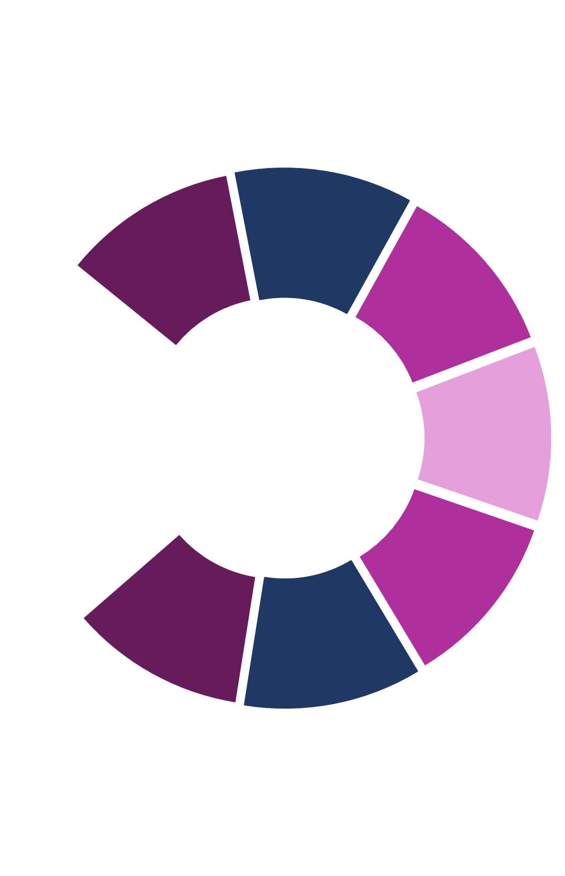
What can you do?
Are you willing to do contribute to this effort?
What would you do differently if you had increased access to secondary use data?
How will our health system and daily lives be improved by secondary use data?
SUDP

Slide 30
What’s the take away and scope of the opportunity for Alberta?
“Alberta is just a few inches away from being able to leapfrog every healthcare system in the world; all the right pieces to the puzzle are available. The pieces just need to be organized.”
Dale Sanders
“Health can generate major economic value – if the healthiest province – a magnet for business of all kinds; many industries related to health; there are major supply chains plus health human resources that can generate value; information to inform decision making is the biggest resource… BUT the key is rapid/low cost access to timely high quality (trusted) health data – a MAJOR untapped global asset”
Dr. Cy Frank

Slide 31
Aspirational Healthcare
“
Imagine if your physician could say this to you:
“I can make a health optimization recommendation to you, informed not only by the latest clinical trials, but also by our local and regional data about patients like you; the real-world health outcomes over time of every patient like you who has had your illness; and the level of your interest and ability to engage in your own care -- and in turn I can tell you within a specified range of confidence, which treatment has the greatest chance of success for a patient specifically like you and how much that treatment will cost."
“

Slide 32
Summary
Data is at the heart and only hope to reduce the cost of health care and improve health outcomes
Data integration and interoperability across formats, sources, and systems is critical to realizing the potential for the secondary use of health data to transform health care
New paradigms in research rely on existing data and allow for more cost effective designs
The aspirational goal of treating individuals (not the average) is at the heart of precision medicine and dependent on rich and diverse data sources for ‘deep’ phenotyping

Slide 33
Thank You

