Slide 1
NPUC Workshop: Advances in Bitumen Processing
Murray Gray
Alberta Innovates
Thursday May 26, 2022

Slide 2
Workshop Objectives
  Inform NPUC members and the Alberta research community on new directions in basic science and emerging technologies for more selective upgrading of bitumen, including:
  a. Selective pathways for sulfur and metals removal
  b. Processing without addition of hydrogen
  2. Inform researchers of industry needs and new directions in bitumen processing

Slide 3
Workshop Steering Committee

Slide 4
Workshop Agenda
  Opening Remarks (Murray Gray)
  Industry Perspectives – Panel Discussion
  (Moderator: Shunlan Liu, Alberta Innovates)
  Session 1: Processes based on new reaction pathways (Chair: Mohamed Ali, CANMET Energy)
  Lunch Break
  Session 2: New fundamentals for bitumen processing (Danuta Sztukowski, CNRL)
  Poster Session – Eight simultaneous Teams sessions
  Workshop Close – at 15:10 please rejoin the main link

Slide 5
National Partial Upgrading Committee (NPUC)
Established in 2015 as a collaborative program
Oilsands producers and government agencies
Partial Upgrading ≡ reducing diluent for bitumen pipeline transport
Collaborations include:
Sharing of technical and scientific information
Policy and market studies
Regulations and specificiations on oilsands products

Slide 6

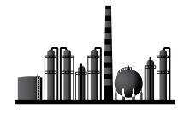

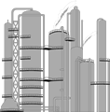

Current Oilsands Operations
Full Upgrading to Synthetic Crude Oil (SCO)
CNRL
Suncor, Cenovus
SCO
Production
Upgrader
Pipeline
Refinery
Diluted Bitumen Shipment to Refineries
CNRL, MEG
Cenovus, Imperial Oil, Suncor
Production
Pipeline
Deep Conversion Refinery
Dilbit
Diluent to reduce viscosity
(Significant volume recycled via pipeline and reused)

Slide 7
Expanding Scope of Bitumen Processing
Diluent
Bitumen or
Bitumen Emulsion
Partially Upgraded Bitumen
Partial
Upgrader
Partial Upgrading
Imperial Oil Kearl
Suncor/Teck Fort Hills
New technologies nearing commercialization
Carbon fibres
Asphaltenes
Carbon materials
Binders and adhesives
Coatings
Bitumen Beyond Combustion
Sequestration
Vanadium

Slide 8
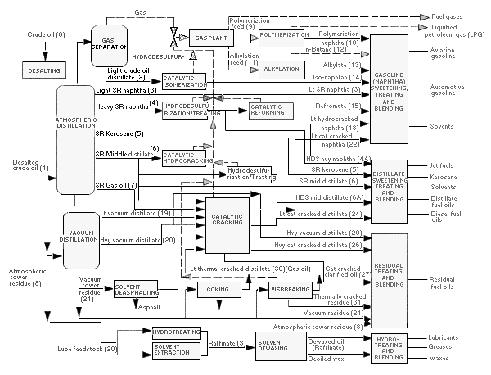
Refinery Processes – High Conversion Refinery

Slide 9
Bitumen Upgrading Overlaps with Refining
Units used in Alberta upgraders or proposed for partial upgraders

Slide 10
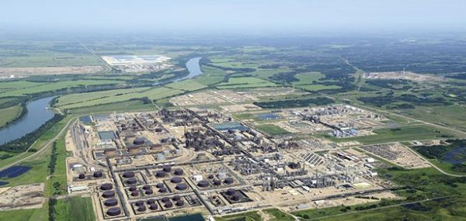
Capital costs for refining and upgrading
Full upgraders cost over $60K/BBL/d
Target for partial upgrading under $30K/BBL/d
Northwest Refinery cost $ 124K/BBL dilbit/d
Supporting facilities can be ½ total cost or more
Northwest Sturgeon Refinery
Processing equipment

Slide 11
GHG Emissions from Upgrading
Pacheco et al., 2019
Delayed coking
Suncor, CNRL Horizon
Hydroconversion
Shell/CNRL
Fluid coking + Hydroconversion, Syncrude

Slide 12
Range of Bitumen Components
Atmospheric
distillate
Bitumen contains over 50% vacuum residue
Molecular weight to over 1200
C₄₀ to C₆₀
Up to 4 sulfur atoms per molecule
N, Ni, V
VGO
Vacuum residue
C₁₄

Slide 13
Current Commercial Options for Processing of Vacuum Residue (VR)
Thermal Cracking, T>390°C
Vacuum Residue
Visbreaking
(Mild Thermal Cracking)
Coking
Hydroconversion
FCC
Two-step processes – thermal cracking then catalysis of fragments
Separate by Distillation or Solvent Separation
Fuel Oils
Asphalt Binders
Asphaltene precipitated for
sequestration or fuel

Slide 14
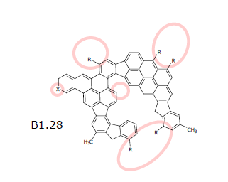
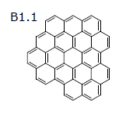
Why is heat is the main option for largest molecules?
80-90 wt% bridged structures
Strong aggregation
10-20 wt% large aromatic groups
Weak aggregation
Non-Contact AFM images from Schuler et al., Energy and Fuels, 2017
Concentrations from Chacon-Patino et al., Energy and Fuels, 2018

Slide 15
Thermal Cracking
Methane, ethane, propane
Heat to > 390°C
Olefins (ethylene etc.)
Vacuum Residue
Bond Breakage
Molecular Rearrangement
Addition
Distillates (C₅ to C₄₀)
Unconverted VR (C₄₀ to C₆₀)
Extremely complex reactions
Very limited control over products
  Time and temperature ≡ “severity”
  Recycle
Coke

Slide 16
Hydroconversion – Catalyst Plus Hydrogen
Methane, ethane, propane
Heat to > 420°C

Olefins (ethylene etc.)
Vacuum Residue
Bond Breakage
Molecular Rearrangement
Addition
Distillates (C₅ to C₄₀)
Catalytic sulfur removal
Unconverted VR (C₄₀ to C₆₀)
Same thermal reactions
Catalyst + hydrogen gives benefits
  Suppress coke formation
  Convert olefins and some sulfur
Consumables and equipment are very expensive

Coke

Slide 17
Specifications for Refining Versus BBC
Application | Important Properties
Pipeline transport | Viscosity at 10-30°C, density, solids, water, olefins
Refining to liquid transport fuels | Stability of asphaltenes, fouling tendency, yields in refinery processes
Carbon Fibre Feeds | Rheology at 150-300°C, Organic solids content, Ability to graphitize, Sulfur, Metals
Asphalt binder feeds | Rheology at -40 to +50°C, Compatibility with polymers, Adhesion, Wax separation, …
High Value Carbon Materials | Unique to each product

Slide 18
Workshop Agenda
  Industry Perspectives – Panel Discussion
  (Moderator: Shunlan Liu, Alberta Innovates)
  Session 1: Processes based on new reaction pathways (Chair: Mohamed Ali, CANMET Energy)
  Lunch Break
  Session 2: New fundamentals for bitumen processing (Chair: Danuta Sztukowski, CNRL)
  Poster Session – Eight simultaneous Teams sessions
  Workshop Close – at 15:10 please rejoin the main link
  Q&A Sessions: Please use the “Chat” function to indicate that you have a question, and for whom

